Slide 1
Tutorial- Physics-driven Multi-Objective Bayesian Optimization (MOBO)
Arpan Biswas
Postdoctoral Research Associate, ORNL

Slide 2

My Background
Education :
Ph.D (Dec 2020) in Mechanical Engineering, Minor- Statistics from Oregon State University
MS (June 2017) in Mechanical Engineering from Oregon State University
Btech (May 2012) in Mechanical Engineering from West Bengal University of Technology, India
Work Experience:
2019 Summer Internship at Proctor & Gamble as PhD Statistician
Software Engineer at Accenture (2012- 2015)
Research Interest:
Computational design and optimization specifically in the early design stage.
Bayesian optimization.
Multi-disciplinary optimization.
Classical and Bayesian statistical modelling.
Uncertainty quantification methods and machine learning.
Research Focus: Arpan’s research focus is minimizing the gap between theoretical knowledge and practical application of the advanced design optimization methods in large scale problems with concentrating on global trade-off between model complexity, convergence and cost.

Slide 3
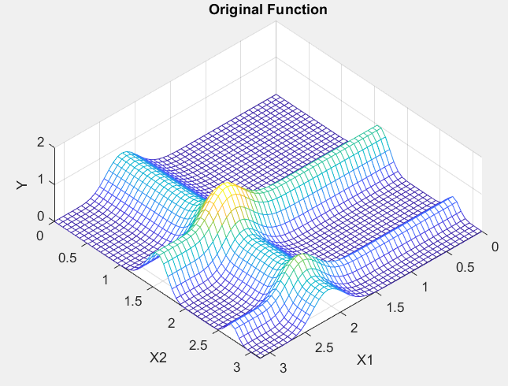
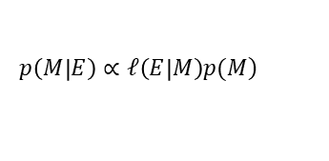
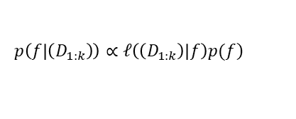
Bayesian Optimization (BO)
Current evaluations
Posterior surrogate model
Select future evaluations
Why called “Bayesian” ?
Bayes Theorem
Expensive evaluations
$$\left.p\left(M | E\right)∝𝓁\left(E | M\right)p(M\right)$$
Augment current and new evaluations
Evidence
Parameter
BO setting:
$$\left.p\left(f | \left(D_{1:k}\right)\right)∝𝓁\left(\left(D_{1:k}\right) | f\right)p(f\right)$$
Posterior Model
Data
Unknown function

Slide 4
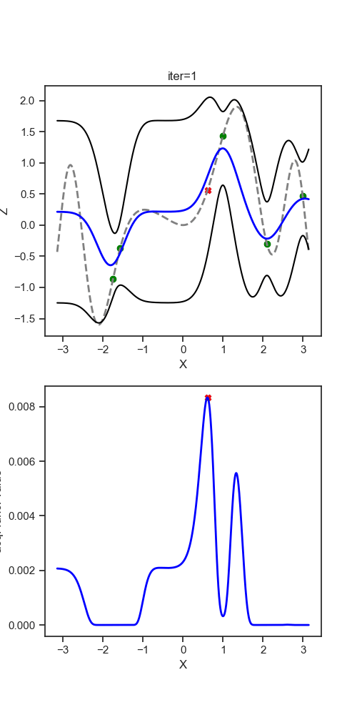
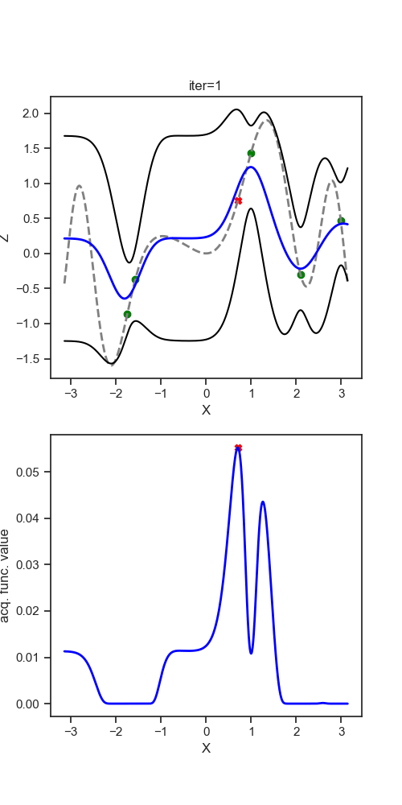
Bayesian Optimization (BO)
Gaussian Process
Acquisition Function
Expected Improvement
Probability of Improvement

Slide 5
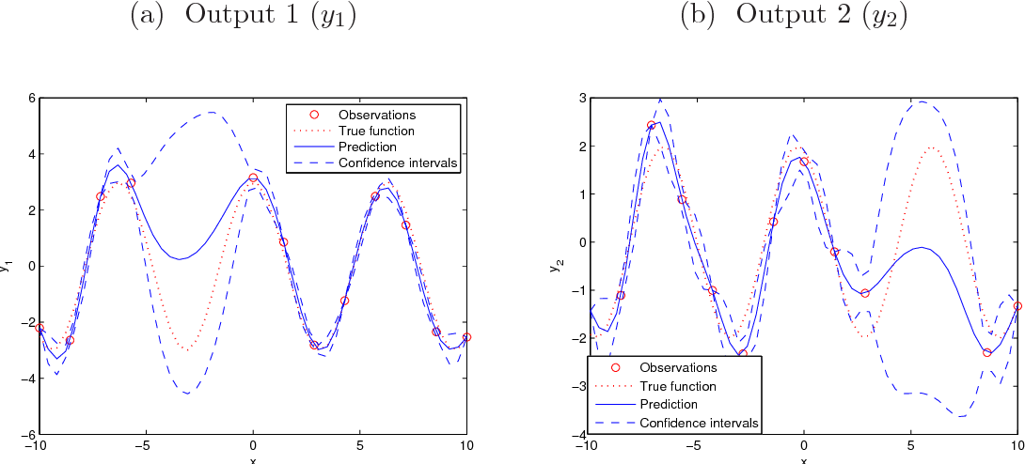
Multi-Objective Bayesian Optimization (MOBO)
Multi-objective Optimization:
Multi-objective Bayesian Optimization:
$$\min{f\left(X\right)=\left[{minf}_{1}\left(X\right), minf_{2}\left(X\right), …. minf_{n}\left(X\right)\right]} s.t X∈ℝ$$
$\min{f\left(X\right)}$where $f\left(X\right)$ is expensive to evaluate
Multi-output Gaussian Process

Slide 6
Multi-Objective Bayesian Optimization (MOBO)
Multi-objective Optimization:
Multi-objective Bayesian Optimization:
$$\min{f\left(X\right)=\left[{minf}_{1}\left(X\right), minf_{2}\left(X\right), …. minf_{n}\left(X\right)\right]} s.t X∈ℝ$$
$\min{f\left(X\right)}$where $f\left(X\right)$ is expensive to evaluate
Hyper-volume acquisition function
Weights NOT defined
Posteriori Approach
Priori Approach
Iteration 1
Ideal solution
Iteration 2
Ideal solution
f₂
f₂
Increase HV
HV
HV
Reference point
f₁
Reference point
f₁

Slide 7
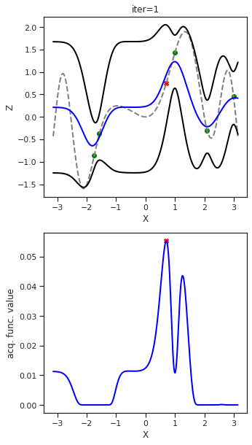
Multi-Objective Bayesian Optimization (MOBO)
Multi-objective Optimization:
Multi-objective Bayesian Optimization:
$$\min{f\left(X\right)=\left[{minf}_{1}\left(X\right), minf_{2}\left(X\right), …. minf_{n}\left(X\right)\right]} s.t X∈ℝ$$
$\min{f\left(X\right)}$where $f\left(X\right)$ is expensive to evaluate
Hyper-volume acquisition function
Weights PRE defined
Posteriori Approach
Priori Approach
Iteration 1
Iteration 2
f₂
f₂
HV
HV
Increase HV
f₁
f₁
2D objective space
2D objective space
1D multi-objective space

Slide 8
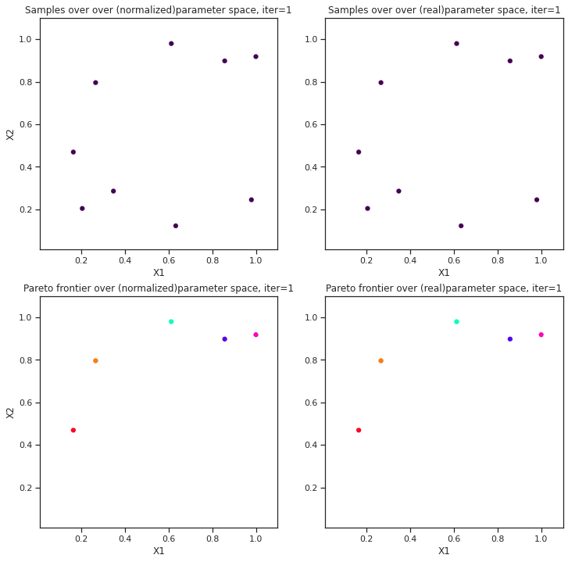
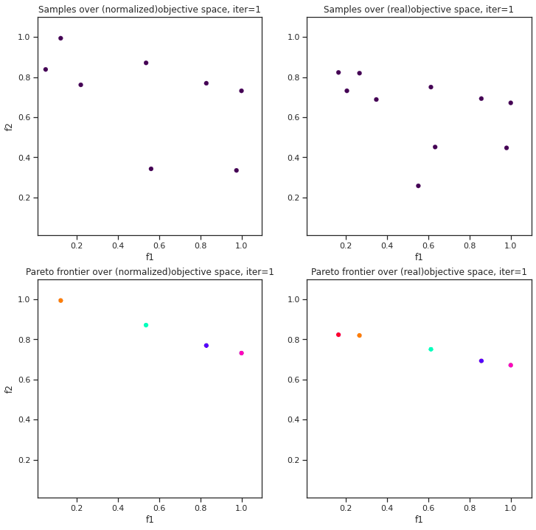
Case Study1 (MOBO)
Numerical Test Problems (Non-Physics): ZDT1
Acquisition Function: qEIHV (Posteriori); Batch_size: 4, Max BO sampling: 50 x Batch_size
f₁
f₂
Ground truth
Building Pareto over design space
Building Pareto over objective space

Slide 9
Initialization:
Define parameter space,
Select target functions,
Select acquisition function,
Set maximum BO iteration,
Set batch size,
Define external field
Select initial points (random)
Physics driven MOBO
Data Augmentation:
Augment Training Data with current and new evaluations
Numerical generative model: 2-4-6 KLGD bulk PZO
Posterior modelling:
Fit GP models for each objectives
Configure hysteresis loop
Train GP:
Optimize hyper-parameters (minimize loss) of each GP models using appropriate optimizer, (eg. Adam) given the training data
Develop physics driven decision tree
Outside MOBO framework
Within MOBO framework
Function evaluation:
Quantify target functions as user selected for objectives
Posterior predictions of unexplored points
Search Strategy:
Choose new points (in batch) from user selected MOO-based acquisition function
Is maximum BO iteration reached?
No
Yes
Stop Model and build Pareto-frontier

Slide 10
Case Study 2- Physics driven Decision Tree
Case Study Theoritical Model: 2-4-6 KLGD for bulk PZO
proposed by -- Anna N. Morozovska and Sergei V. Kalilin,
developed by -- Eugene A. Eliseev (in Mathematica) and Arpan Biswas (in Python)
Hysteresis Loop
Zero Loop (PE)
One Loop (FE)
Two Loop (AFE)
Total Energy
Linear
Loop Width
No shift
Sigmoid
No separation
Energy Storage
Loop Shift
Positive (right) shift
Two waves
Separation
Energy Loss
Negative (left) shift

Slide 11
Case Study 2- Physics driven Decision Tree
Case Study Theoritical Model: 2-4-6 KLGD for bulk PZO
proposed by -- Anna N. Morozovska and Sergei V. Kalilin,
developed by -- Eugene A. Eliseev (in Mathematica) and Arpan Biswas (in Python)
Let’s walkthrough the notebook tutorial ……………………..
https://github.com/arpanbiswas52/MOBO_AFI_Supplements/blob/main/MLWorkshop_PhysicsDriven_MOBO_%28PZO%29_tutorial.ipynb

Slide 12
Summary
Here, we extract multiple functionalities from hysteresis loops, build a physics-driven prior knowledge and optimize multiple functionalities jointly with classical MOBO architecture– Physics-driven MOBO.
Two approach to compute acquisition function- Priori and Posteriori.
There is no universal best method.
Posteriori approach seems fast to learn but can get stuck.
Priori approach seems to explore more, user have control on weights associated to objectives, however likely to need more evaluations.
Computational cost/complexity of posteriori approach is higher than priori approach.
In this tutorial, we focused on Unconstrained MOBO, in future we will extend to constrained MOBO (more complex).
Can be further extended towards theory-experiment matching.
Fit experimental data as prior knowledge after converting into various functionalities in a decision tree.
guiding the experiments by exploring towards the region of interest in high-dimensional multi-functionality space, and thereby reducing time and effort.
Full Notebook: https://github.com/arpanbiswas52/MOBO_PhysicsBasedModels

Slide 13

Acknowledgement
Sergei. V. Kalinin
Anna N. Morozovska
Eugene A. Eliseev
Maxim Ziatdinov
Rama K. Vasudevan

Slide 14
Case Study 2- Physics driven MOBO
Maximize Energy Storage, Maximize Energy Loss
Parameter space $T=\left[255, 350\right]K, n_{ρ}=\left[6, 8\right] where ρ={10}^{n_{ρ}}, h=50nm, Δ_{G}=0.2eV$.
Batch_size: 4, Max BO sampling: 30 x Batch_size
Hysteresis Loops: FE

Slide 15
Case Study 2- Physics driven MOBO
Maximize Energy Storage, Maximize Energy Loss
Parameter space$T=\left[255, 410\right]K,n_{ρ}=\left[−3, 3\right] where ρ={10}^{n_{ρ}}, h=5nm, Δ_{G}=0.2eV$.
Batch_size: 4, Max BO sampling: 30 x Batch_size
Hysteresis Loops: AFE

Slide 16
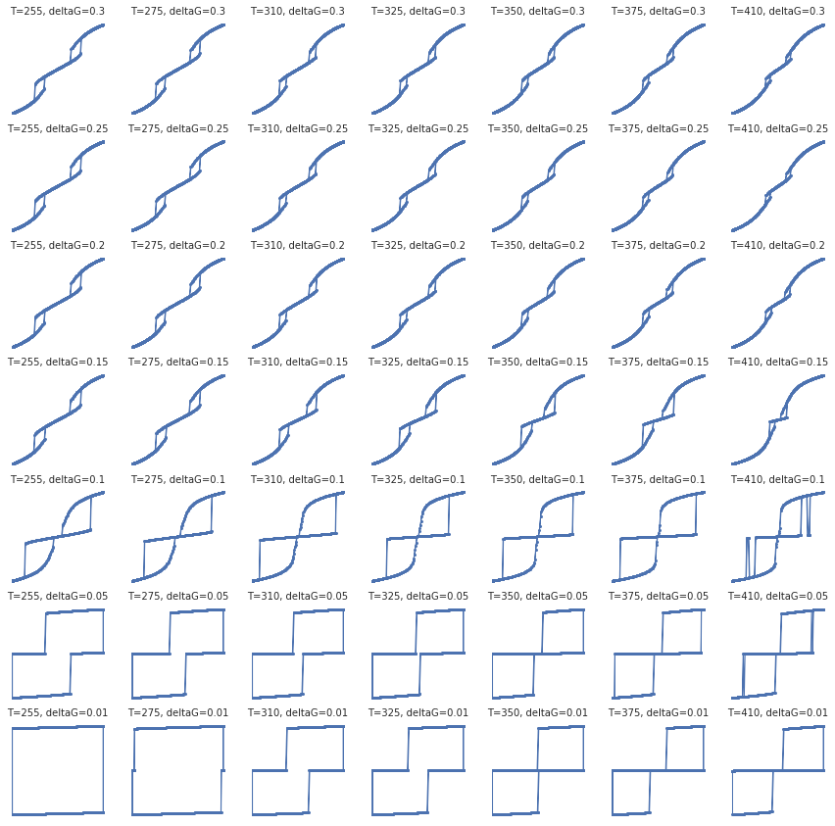
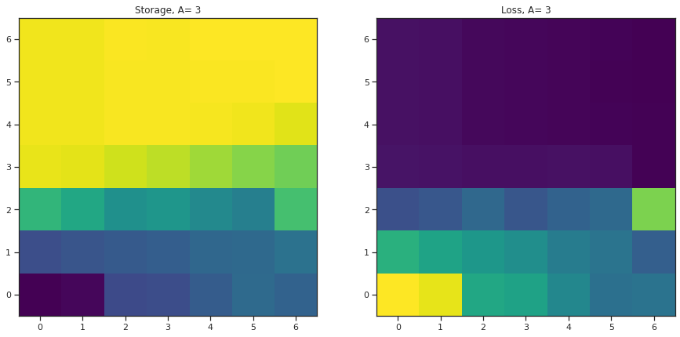
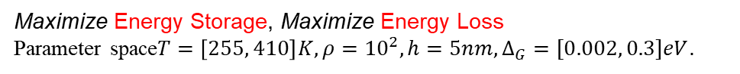
Case Study 2- Physics driven MOBO
Maximize Energy Storage, Maximize Energy Loss
Parameter space$T=\left[255, 410\right]K, ρ={10}^{2}, h=5nm, Δ_{G}=[0.002, 0.3]eV$.
Batch_size: 4, Max BO sampling: 30 x Batch_size
f1: Storage
qEIHV
Surface ion energy (eV)
Surface ion energy (eV)
Loss
f2: Loss
Temperature (K)
Storage
Hysteresis Loops: FE and AFE
Temperature (K)

Slide 17
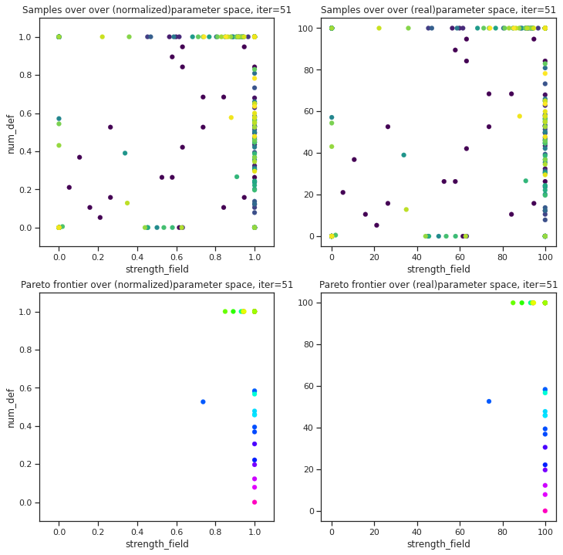
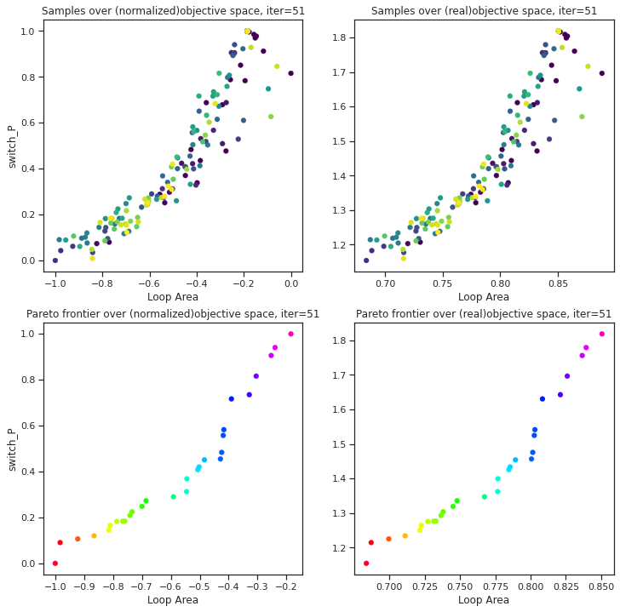
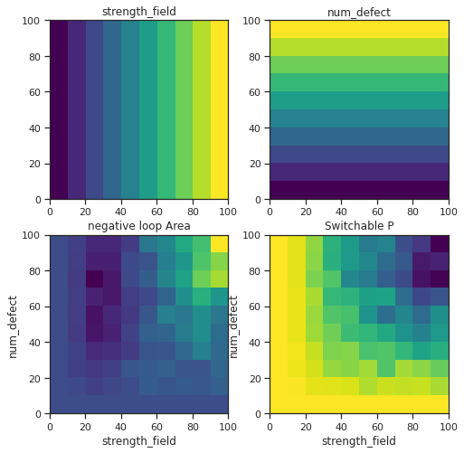
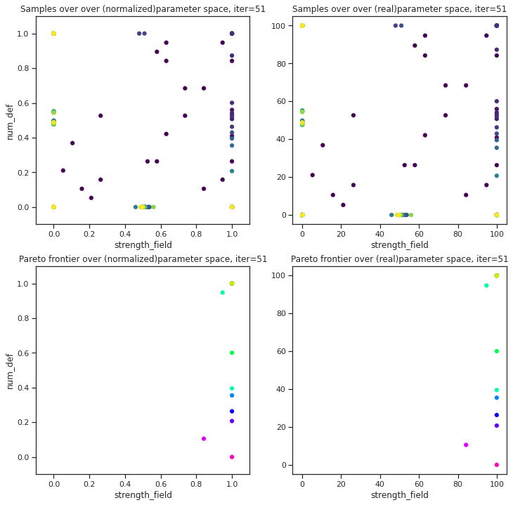
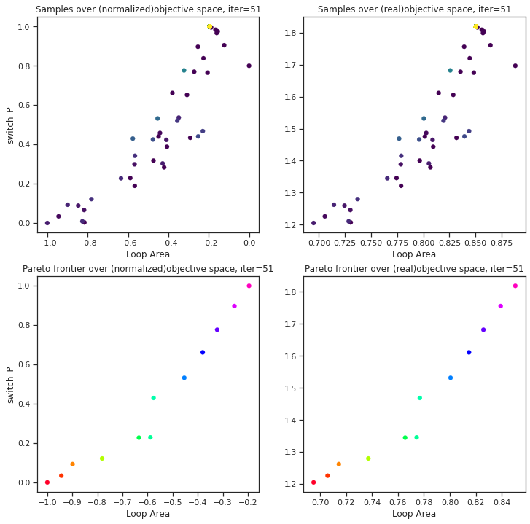
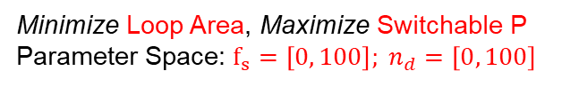
Case Study 3- Physics driven MOBO
Physics-based Numerical Model: FerroSim (developed by Rama K. Vasudevan)
Batch_size: 4, Max BO sampling: 50 x Batch_size
Minimize Loop Area, Maximize Switchable P
Parameter Space: $f_{s}=\left[0, 100\right]; n_{d}=\left[0, 100\right]$
qParEGO
f1: Negative loop area
Switch P
#defect
#defect
qEIHV
f2: Switch P
Switch P
Field strength
Loop Area

Slide 18
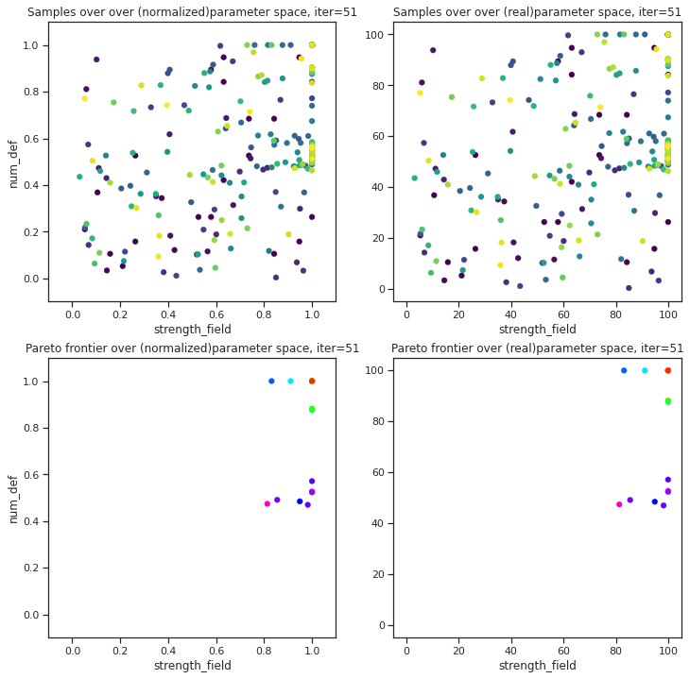
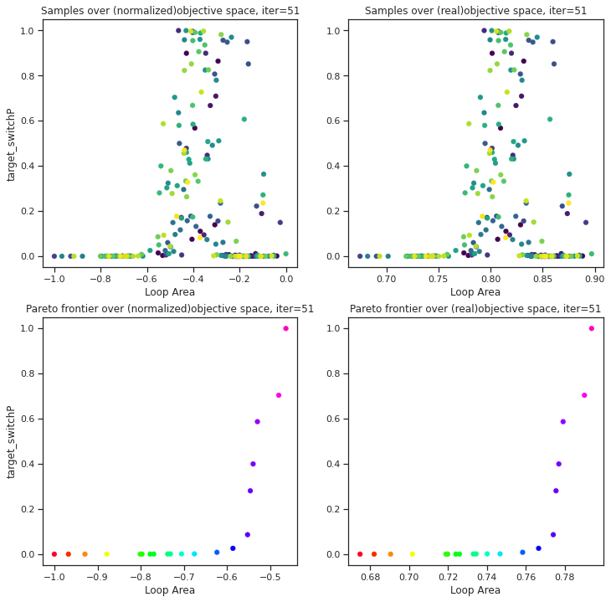
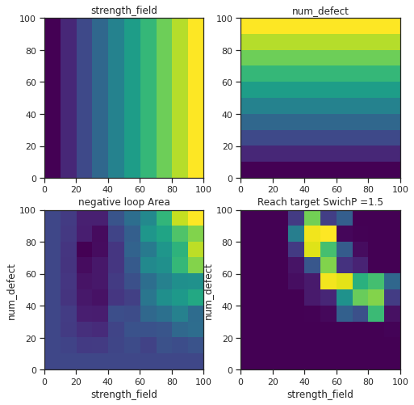
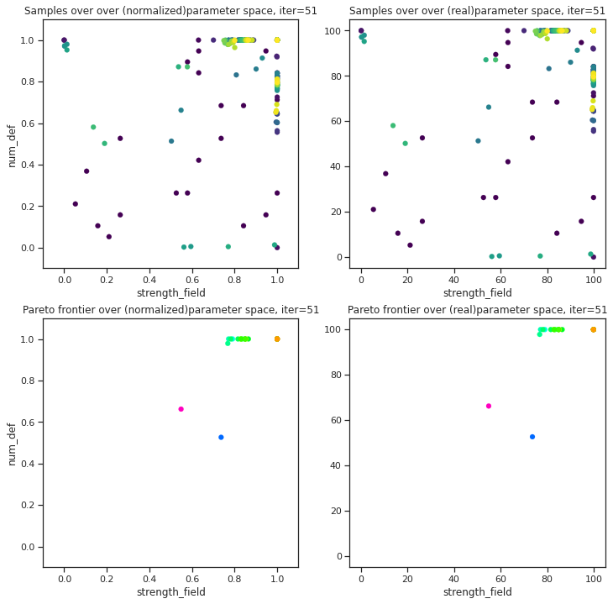
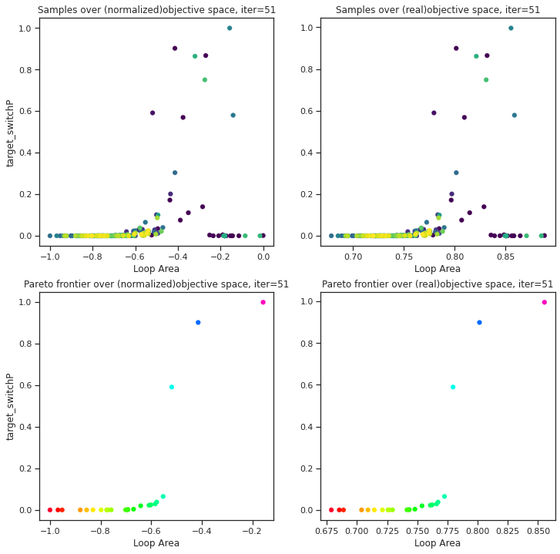
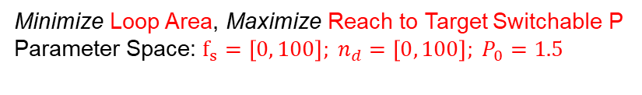
Case Study 3- Physics driven MOBO
Physics-based Numerical Model: FerroSim (developed by Rama K. Vasudevan)
Batch_size: 4, Max BO sampling: 50 x Batch_size
Minimize Loop Area, Maximize Reach to Target Switchable P
Parameter Space: $f_{s}=\left[0, 100\right]; n_{d}=\left[0, 100\right]; P_{0}=1.5$
qParEGO
f1: Negative loop area
Reach to target P =1.5
#defect
#defect
qEIHV
f2: Switch P
Reach to target P =1.5
Field strength
Loop Area

Slide 19
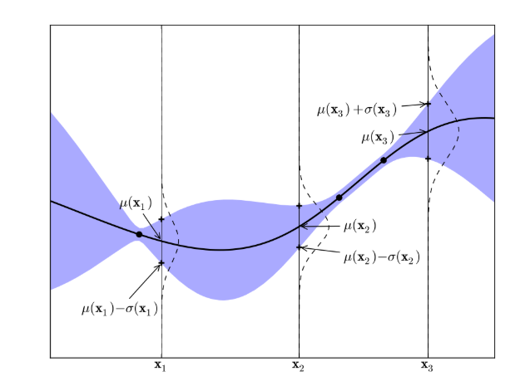
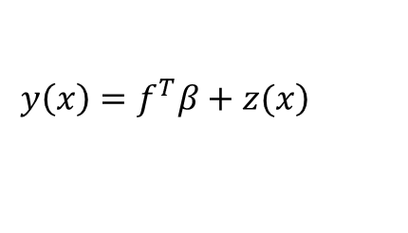
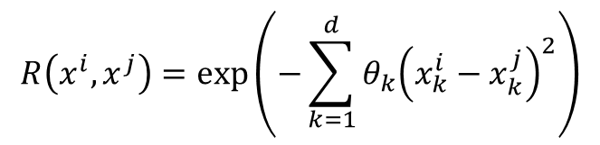
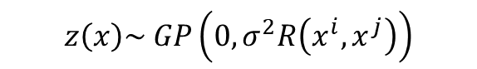
Surrogate Modelling
Gaussian Process
$$\left.y\left(x\right)=f^{T}β+z(x\right)$$
0th/1st/2nd order Polynomial Regression
$$z\left(x\right)\sim GP\left(0,σ^{2}R\left(x^{i},x^{j}\right)\right)$$
$$R\left(x^{i},x^{j}\right)=\exp\left(−\sum_{k=1}^{d}{θ_{k}{\left(x_{k}^{i}−x_{k}^{j}\right)}^{2}}\right)$$
hyperparameters
Predictive Posterior distribution
$$P\left(y_{t+1}^{`}\right|D_{t},x`_{t+1},σ_{t}^{2}, θ_{t})= N(μ(y`_{t}\left({x`}_{t+1}\right)), σ^{2}(y`_{t}\left({x`}_{t+1}\right)))$$

Slide 20
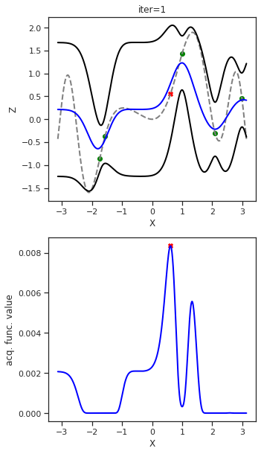
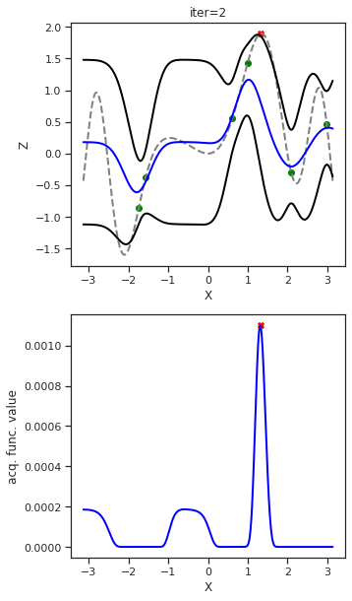
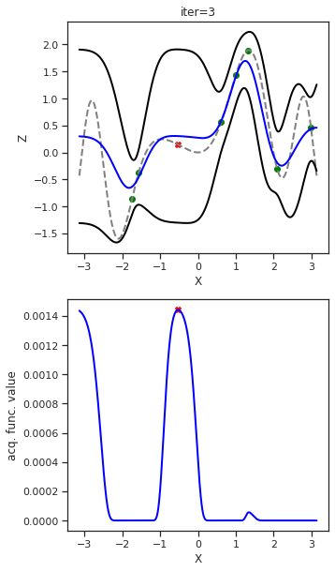
Acquisition Function
Gaussian Process
Acquisition Function

Slide 21
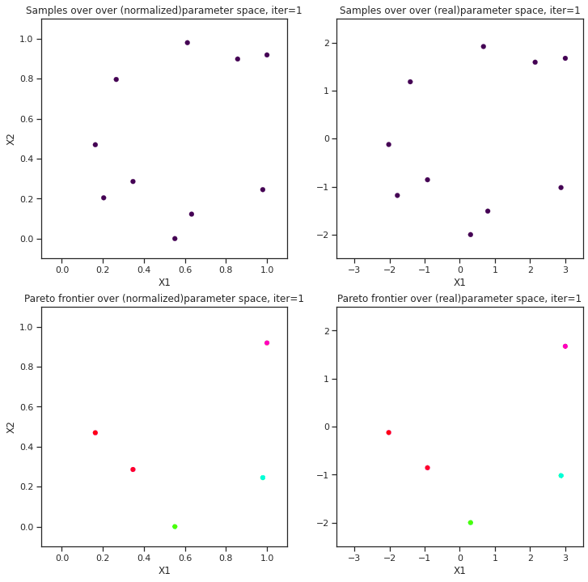
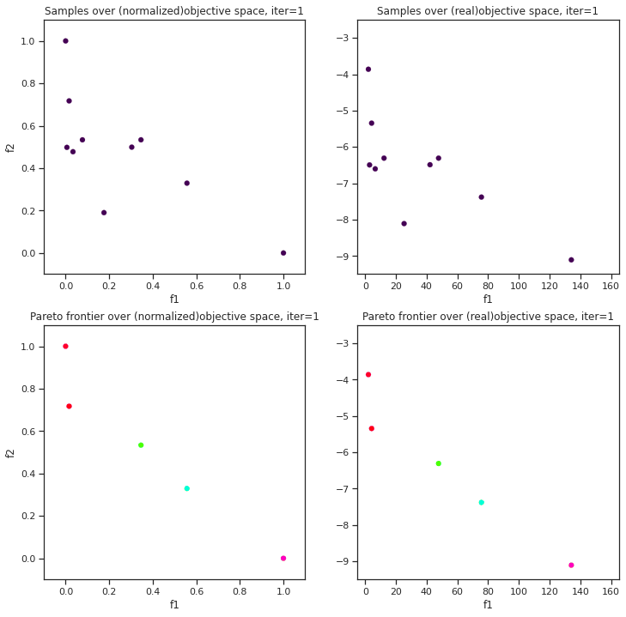
Case Study1 (MOBO)
Numerical Test Problems (Non-Physics):
6-Hump Camel Back – Inversed Ackley’s Path (6HC-IAP)
Acquisition Function: qParEGO (Priori); Batch_size: 4, Max BO sampling: 50 x Batch_size
f₁
f₂
Ground truth
Building Pareto over design space
Building Pareto over objective space

Slide 22
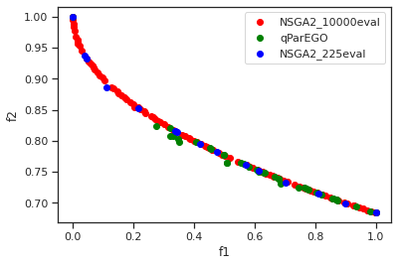
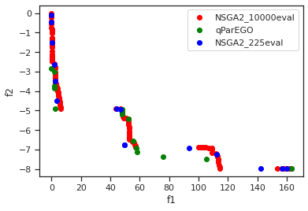
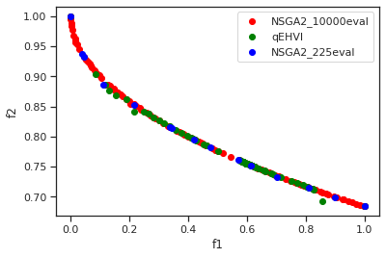
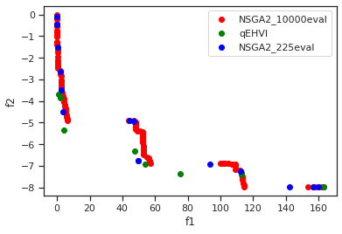
Case Study1 (MOBO)
Numerical Test Problems (Non-Physics): ZDT1
Numerical Test Problems (Non-Physics):
6-Hump Camel Back – Inversed Ackley’s Path (6HC-IAP)

Slide 23
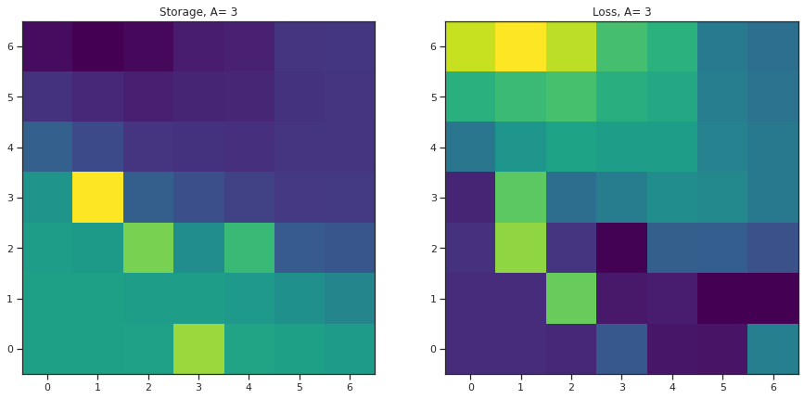
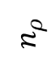
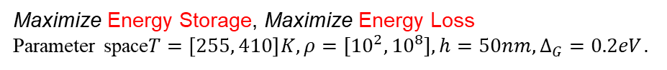
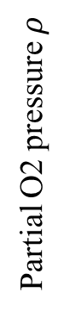
Case Study 2- Physics driven MOBO
Maximize Energy Storage, Maximize Energy Loss
Parameter space$T=\left[255, 410\right]K, ρ={[10}^{2}, {10}^{8}], h=50nm, Δ_{G}=0.2eV$.
Batch_size: 4, Max BO sampling: 30 x Batch_size
f1: Storage
qParEGO
$$n_{ρ}$$
Loss
Partial O2 pressure $ρ$
f2: Loss
Temperature (K)
Storage
Hysteresis Loops: FE and AFE
Temperature (K)

Slide 24
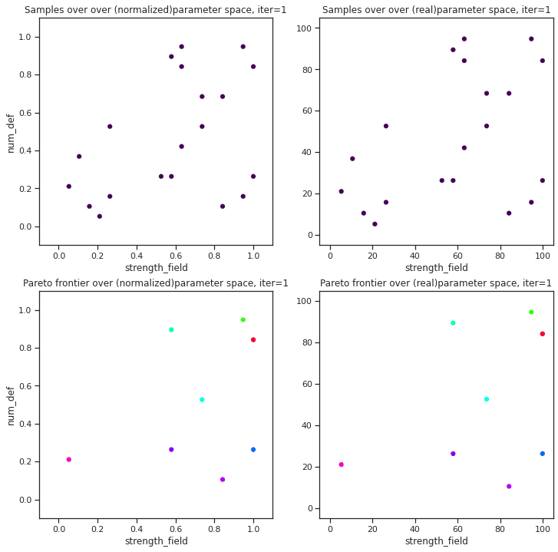
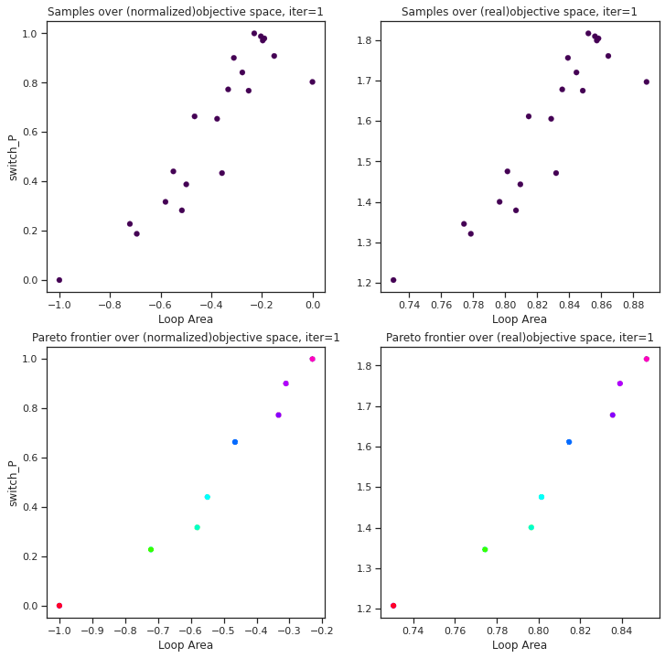

Case Study (MOBO)
Physics-based Numerical Model: FerroSim (developed by Rama K. Vasudevan)
Batch_size: 4, Max BO sampling: 50 x Batch_size
Minimize Loop Area, Maximize Switchable P
Parameter Space: $f_{s}=\left[0, 100\right]; n_{d}=\left[0, 100\right]$
Building Pareto over design space
Building Pareto over objective space
Ground truth

Slide 25
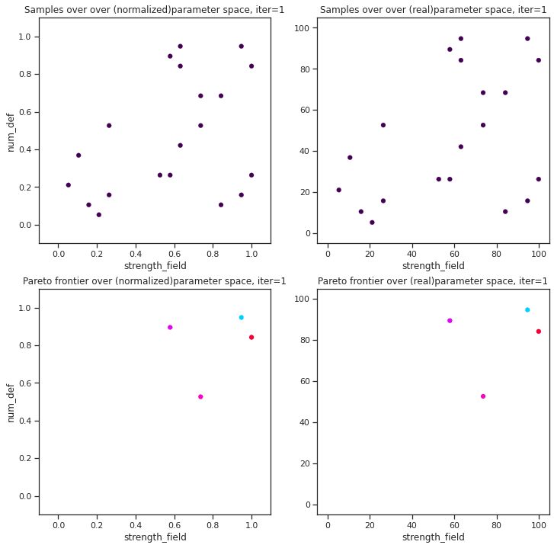
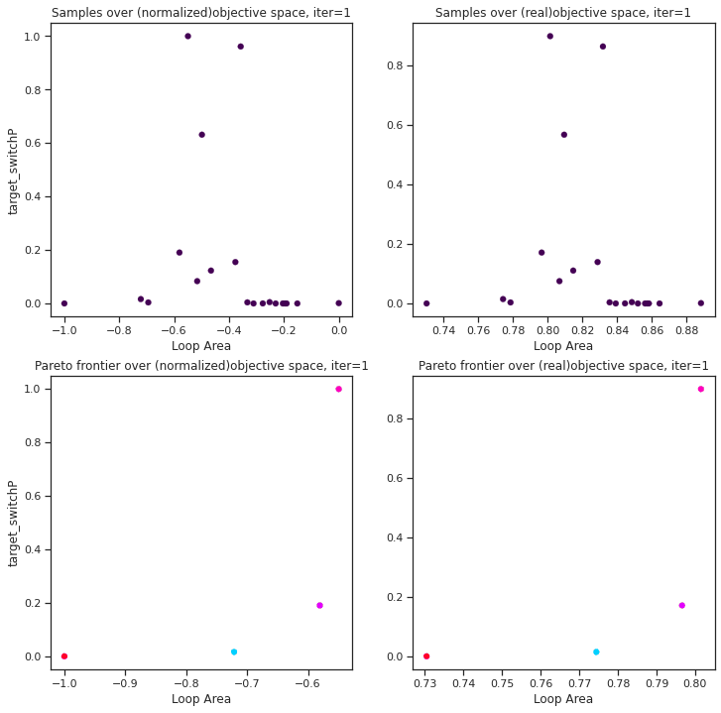
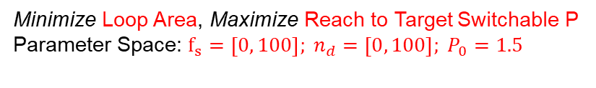
Case Study (MOBO)
Physics-based Numerical Model: FerroSim (developed by Rama K. Vasudevan)
Batch_size: 4, Max BO sampling: 50 x Batch_size
Minimize Loop Area, Maximize Reach to Target Switchable P
Parameter Space: $f_{s}=\left[0, 100\right]; n_{d}=\left[0, 100\right]; P_{0}=1.5$
Building Pareto over design space
Building Pareto over objective space
Ground truth

Slide 26
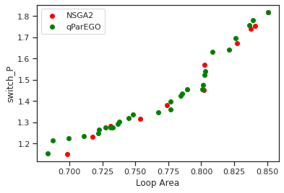
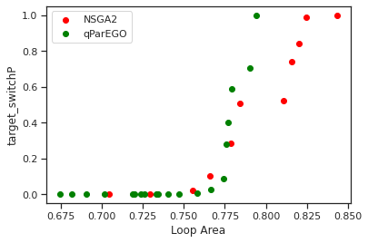
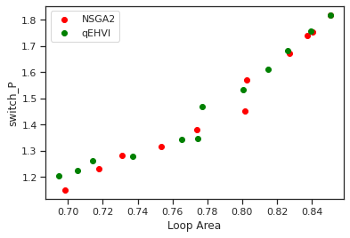
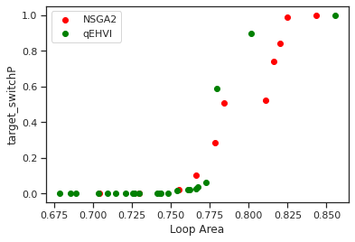
Case Study 3 (MOBO)
Ferrosim: Minimize Loop Area, Maximize Switchable P
Ferrosim: Minimize Loop Area, Maximize Switchable P

